Slide 1
Fraud Detection in Financial Transactions
By : Afeef Anver Sha

Slide 2
TABLE OF CONTENTS
Project Overview
Dataset Description
Fraud Data Characteristics
Exploratory Data Analysis (EDA)
PreProcessing Steps
Feature Engineering Summary
Models Evaluated
Best Model
Model Performance Metrics
Deployment Overview
Streamlit App Workflow
System Architecture
Buisness Impacts

Slide 3
Project Overview
Digital financial fraud is rapidly increasing.
This project aims to enhance the accuracy of detecting fraud in mobile financial transactions. By leveraging machine learning, the project seeks to predict fraudulent transactions with high precision.
The goal is to develop a robust machine learning model to accurately identify fraudulent transactions in real-time , enabling the company to improve security, reduce financial losses, and gain insights into factors contributing to transaction fraud.
End-to-end workflow:
EDA → Preprocessing → Feature Engineering → ML Models → Evaluation → Deployment
Real-world applications:
Banking
E-commerce
Mobile money transfers
Fintech security systems

Slide 4
Dataset Description
Columns in dataset:
step — hour of the simulation (1 step = 1 hour)
type — CASH-IN, CASH-OUT, DEBIT, PAYMENT, TRANSFER
amount — transaction amount
nameOrig — sender
oldbalanceOrg / newbalanceOrg — sender balance before & after
nameDest — receiver
oldbalanceDest / newbalanceDest — receiver balance
isFraud — 1 = fraud, 0 = genuine
Important Insight:
Fraud occurs only in TRANSFER and CASH_OUT transactions.

Slide 5
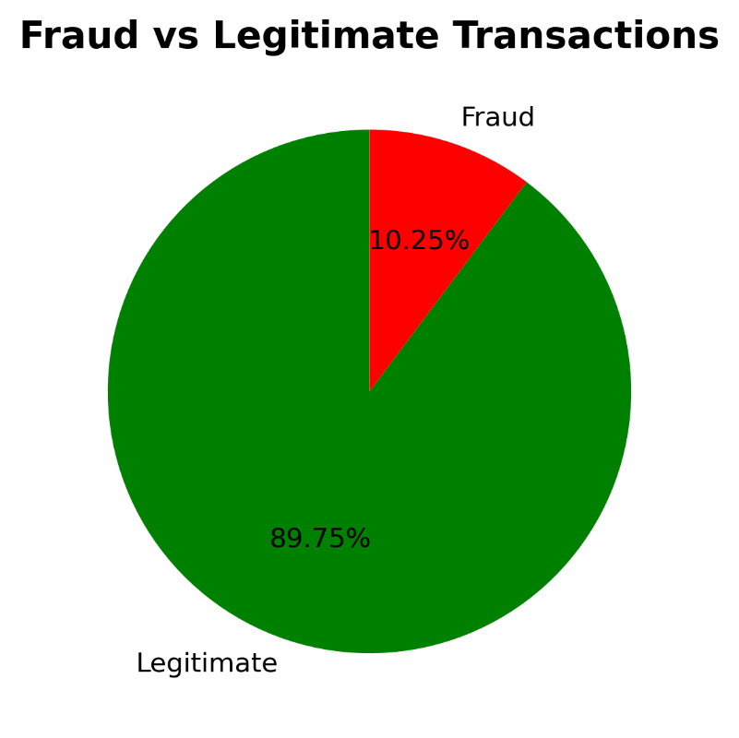
Fraud Data Characteristics
Fraud cases are extremely rare (<1%) → heavy imbalance.
Fraud pattern:
  Transfer money from hacked account
  Immediately cash out via another account
Fraud origin accounts usually start with zero balance.
Receiver accounts often show balance inconsistencies.
Conclusion: Fraud has recognizable financial behavior patterns.

Slide 6
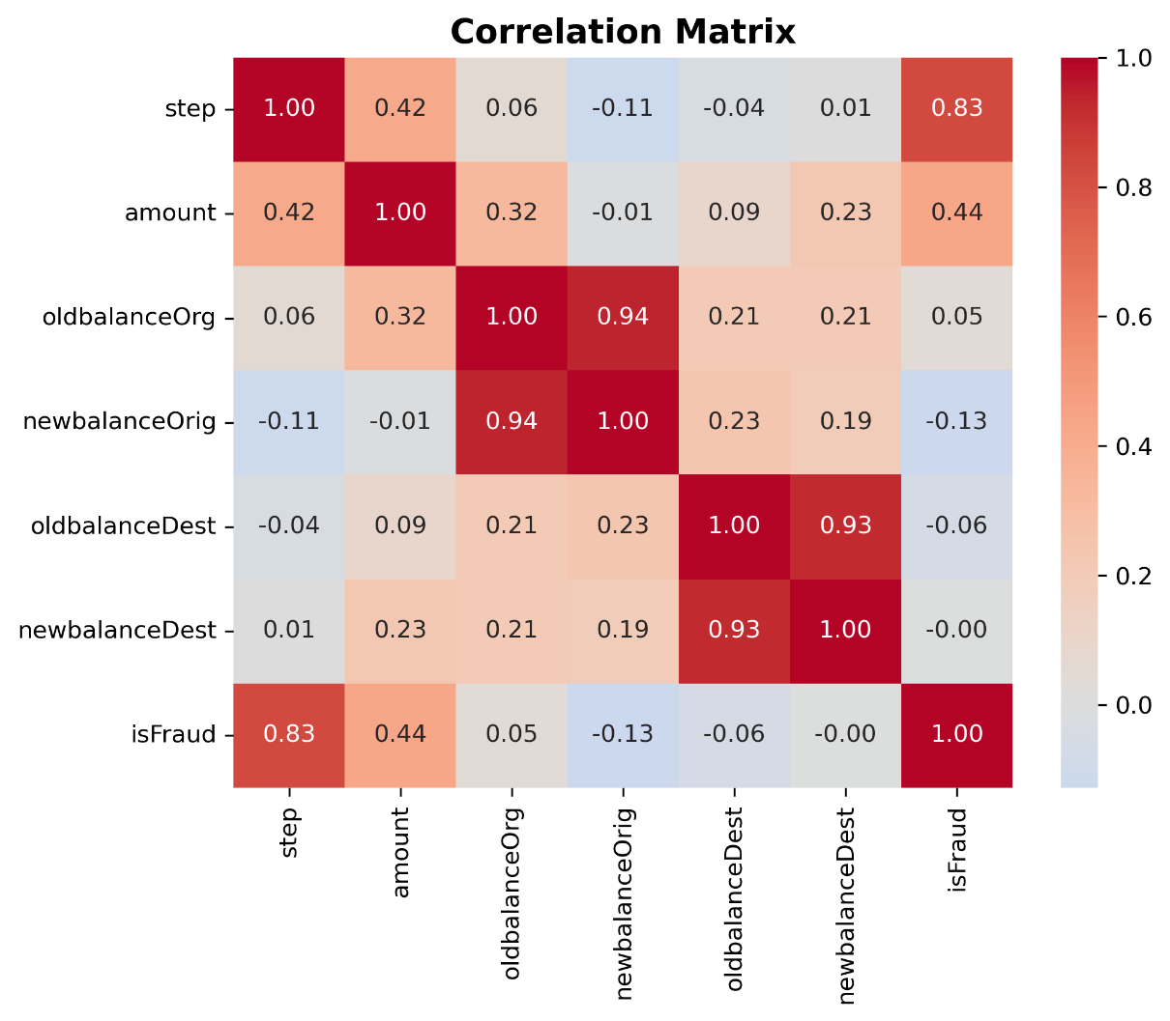

Slide 7
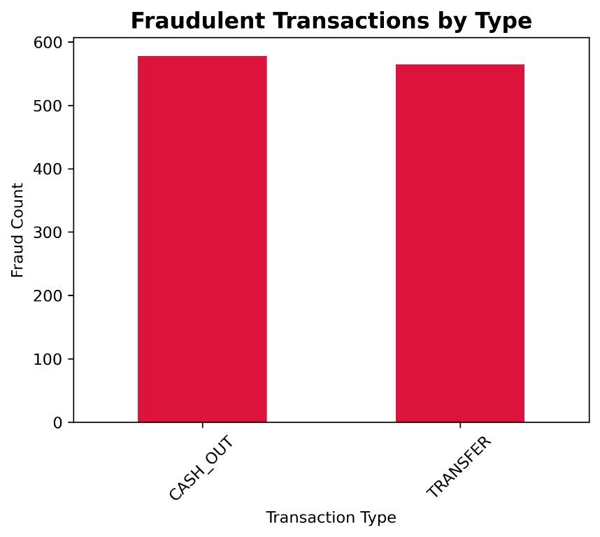
Exploratory Data Analysis (EDA)
Key observations:
Fraud is highly imbalanced → SMOTE required.
Fraud transaction amounts differ from normal transactions.
CASH_OUT and TRANSFER transaction types dominate fraud.
Correlation shows balance-related features are highly significant.
Many fraudulent senders have oldbalanceOrg = amount → zero afterwards.

Slide 8
Preprocessing Steps
Dropped high-cardinality fields:
  nameOrig
  nameDest
Encoded transaction type using One-Hot Encoding
Engineered features:
  org_diff = oldbalanceOrg – newbalanceOrg
  dest_diff = newbalanceDest – oldbalanceDest
  isZeroOrigin flag
Balanced data using SMOTE
Standardized numerical features with StandardScaler

Slide 9
Feature Engineering Summary
Created powerful features:
  org_diff → how much money left sender
  dest_diff → how much money arrived at receiver
  zero_balance_flag → many fraud cases start with zero
  one-hot encoded types → identifies fraud-prone transaction types
Result: All engineered features improved model performance.

Slide 10
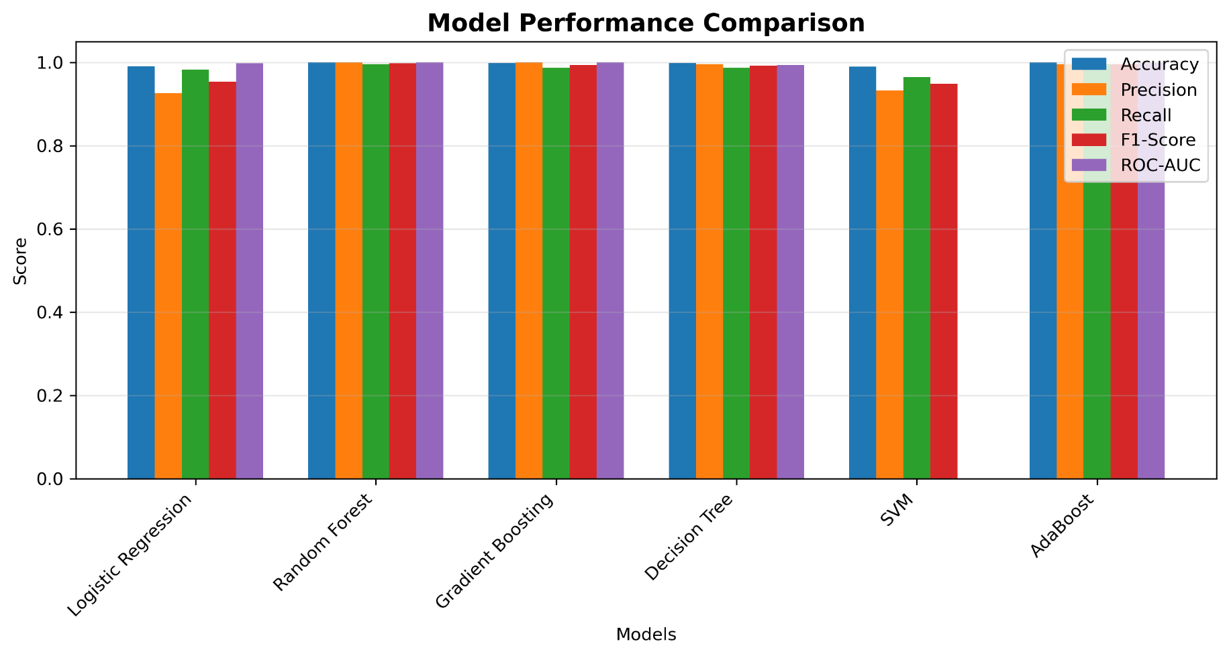
Models Evaluated
Models tested:
  Logistic Regression
  Random Forest
  Gradient Boosting
  Decision Tree
  SVM
  AdaBoost
Evaluation metrics:
  Accuracy
  Precision
  Recall
  F1-score
  ROC-AUC
  Confusion matrices

Slide 11
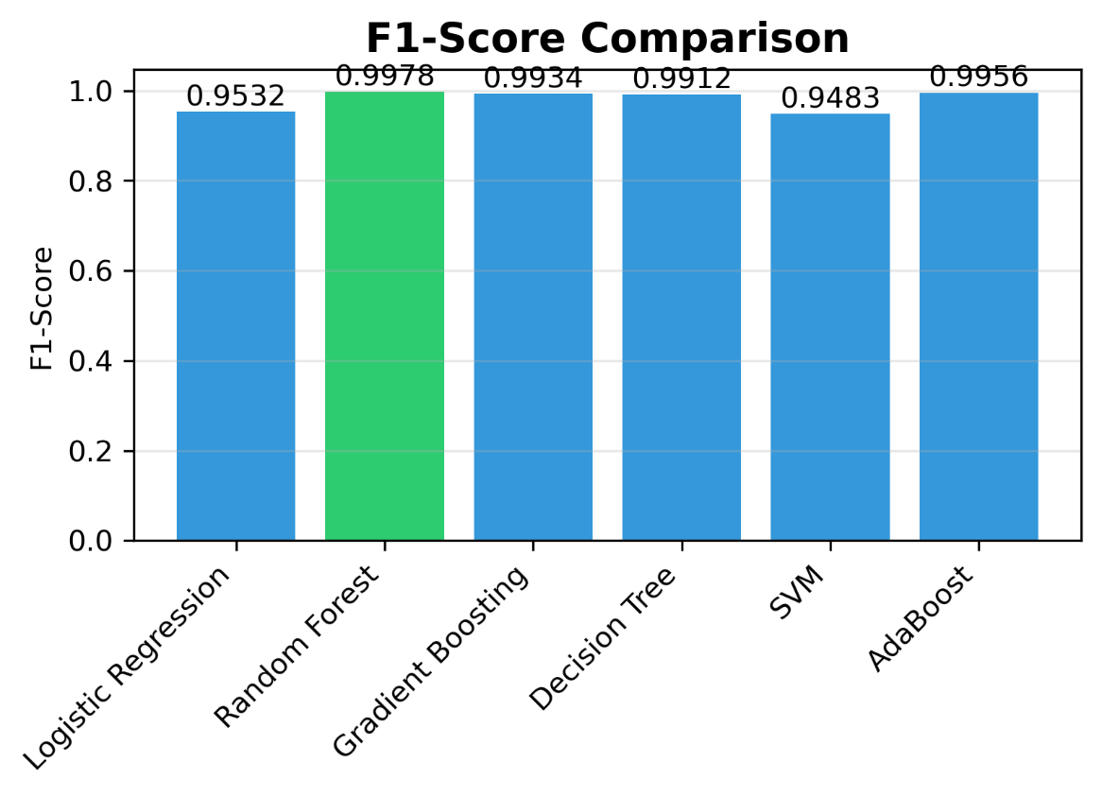

Slide 12
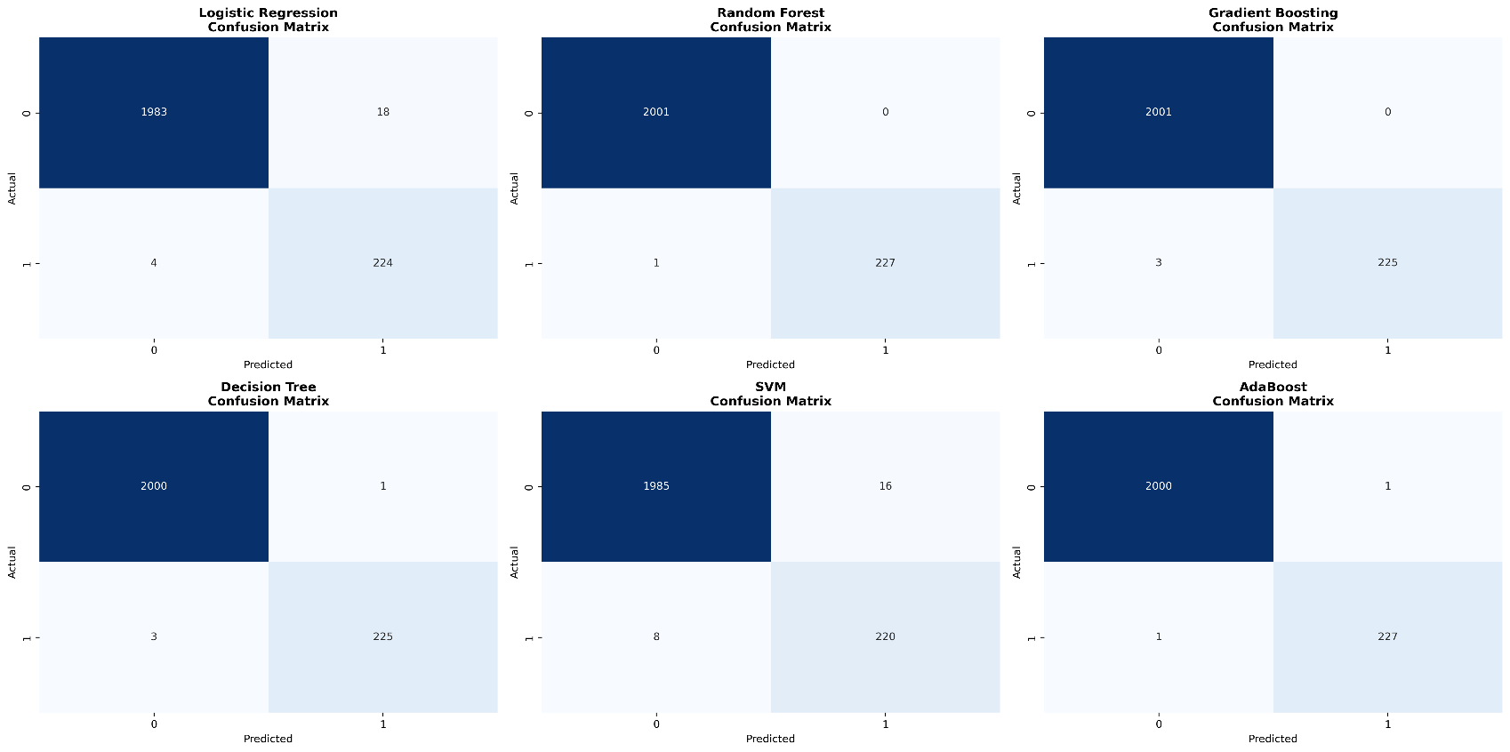

Slide 13
Best Model: Random Forest
Why Random Forest performed best:
  Handles non-linear patterns very well
  Strong recall for fraud detection
  More stable than single decision trees
  Works well with balanced data (SMOTE)
  Good performance without heavy hyperparameter tuning
Selected Model for Deployment: Random Forest

Slide 14
Model Performance Metrics
Accuracy: ~99%
Precision: high
Recall: high → important in fraud detection
F1-score: strong
ROC-AUC: excellent
Confusion matrix:
  Very low false negatives
  Acceptable false positives

Slide 15
Deployment Overview
Deployment steps:
Trained model saved → model.pkl
Preprocessing scaler saved → scaler.pkl
Built Streamlit application
User enters transaction features
Backend applies preprocessing + Random Forest model
UI outputs:
  Fraud (1) or Not Fraud (0)
  Fraud probability

Slide 16
Deployment Overview
1. Single Transaction Prediction
User enters all transaction attributes manually
App preprocesses → Random Forest model predicts
Output shows:
  Fraud / Not Fraud
  Probability score
Tools Used:
Streamlit
Pandas
Scikit-learn
Joblib
2. Bulk Prediction via CSV Upload
User uploads a CSV file with multiple transactions
App automatically:
  Reads the file
  Preprocesses columns
  Applies scaling
  Generates fraud predictions for all rows
Output: downloadable CSV with predictions

Slide 17
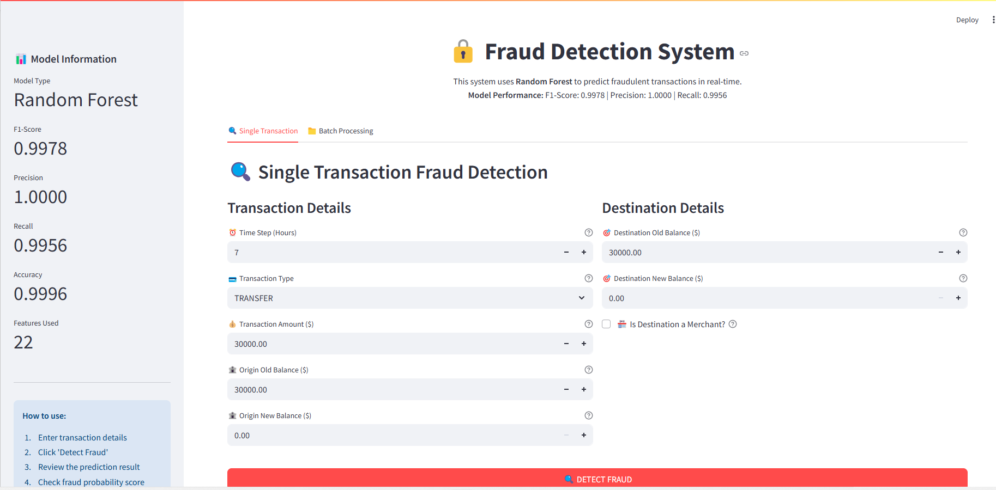
Streamlit App Workflow
Mode 1: Manual Single Prediction
User Inputs → Preprocessing → Random Forest Model → Fraud Result

Slide 18
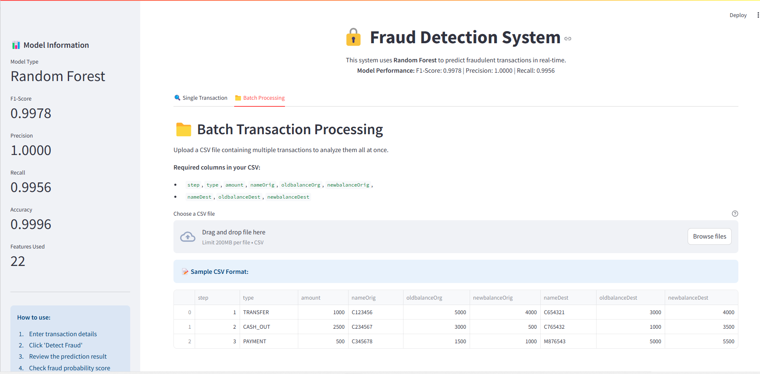
Streamlit App Workflow
Mode 2: CSV Upload
Upload CSV → Validate Columns → Preprocessing → Batch Prediction → Download Output CSV

Slide 19
System
Architecture
User UI (Streamlit App)
Manual Input Mode CSV Upload Mode
Preprocessing Pipe
Batch
Preprocessing Pipe
Random Forest Model
Random Forest Model (Loop)
Fraud Result
Output CSV File

Slide 20
Business Impact
Real-time fraud detection
Reduced financial losses
Protects customer accounts
Improves trust in digital payment systems
Helps financial institutions meet compliance standards
Add the CSV-upload advantages:
  Enables processing thousands of transactions at once
  Allows banks/fintechs to upload daily logs
  Improves operational efficiency
  Supports real-world batch fraud detection workflows
  Can scale to millions of transactions per day

Slide 21
Questions ?

Slide 22
Thank You!

